Slide 1


The Clean Development Mechanism’s effect on carbon market development in the sugar sectors of India and Brazil
Conference on Environmental Policy
APPAM – Korea Development Institute – University of Maryland
Seoul, Korea
12 June 2009
Prof. Nathan E. Hultman | hultman@umd.edu
School of Public Policy, University of Maryland
Assoc Director, Joint Global Change Research Inst., Pacific NW National Laboratory
Assoc Fellow, Institute for Science & Society, University of Oxford
Prof. Simone Pulver
Fulbright Senior Research Scholar, Jawaharlal Nehru University, India
Joukowsky Family Asst. Professor (Research), Watson Institute, Brown University
Asst. Professor, Program in Environmental Studies, Univ of California Santa Barbara
Ranjit Deshmukh
Research Scholar, Pune India
Leticia Guimarães
University of Maryland School of Public Policy

Slide 2
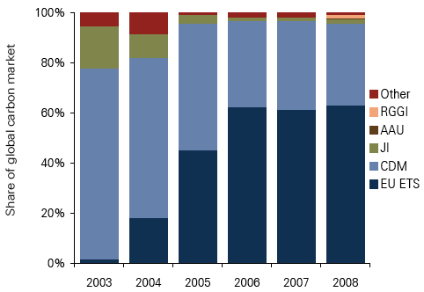
Relative share of emissions trading policy platforms over time
Source: Carbon 2009, PointCarbon LLC

Slide 3
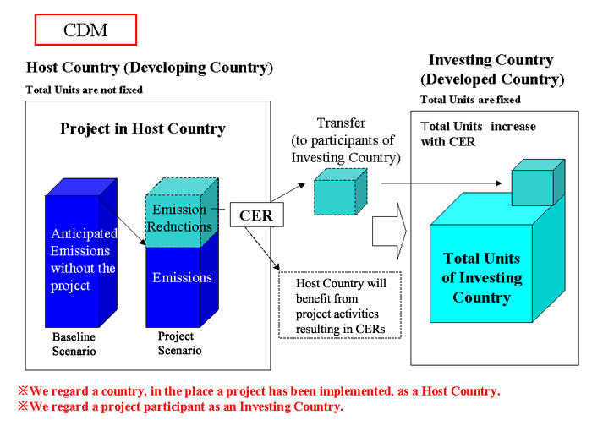
CDM: How it works
Notes:
Sets up “flexibility mechanisms” to meet targets
Emissions trading
Joint-implementation (financing in Annex I countries)
Clean Development mechanism (financing in non-Annex I countries)
Mechanisms “should be” supplemental to domestic action

Slide 4
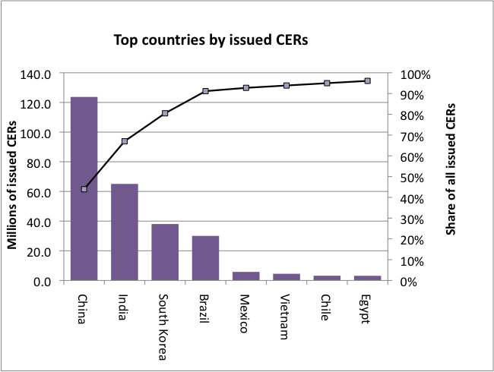
Top eight CDM countries by historical CER issuance
Issued CERs
Top four account for 91%
India = 23%
Brazil = 11%
Source: Risø Centre CDM Pipeline May 2009

Slide 5
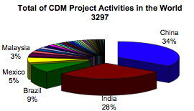
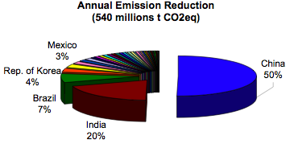
Number of projects
volume of CERs
Source: UNFCCC, 5 May 2008

Slide 6
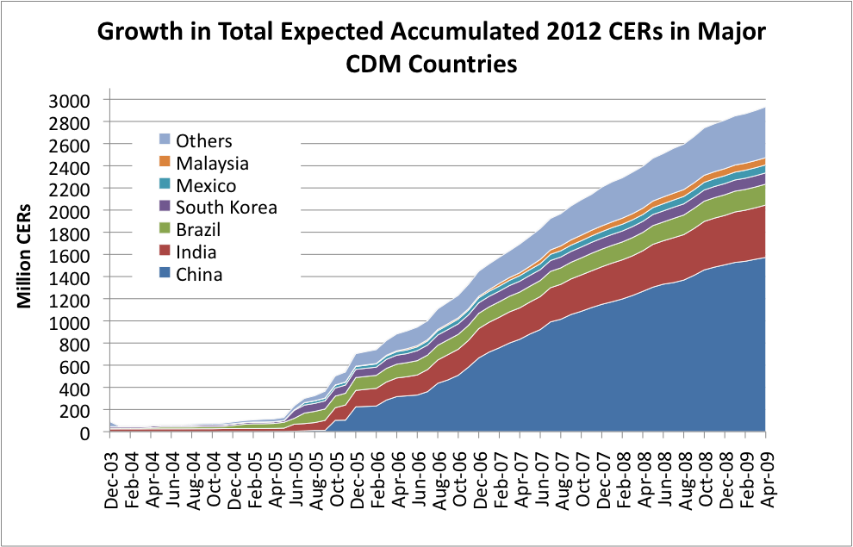
Growth in the total expected accumulated 2012 CERs by country, 2003-2009
Source: Risø Centre CDM Pipeline May 2009

Slide 7
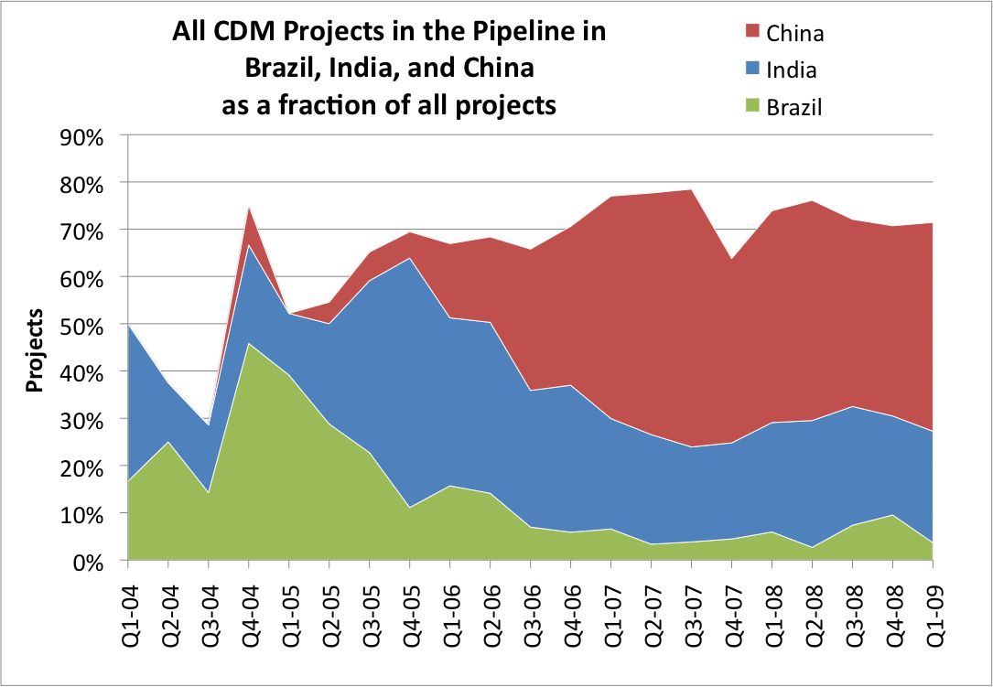
Relative share of emissions trading policy platforms over time
Brazil = 46% of projects in late 2004
India = 53% of projects in late 2005
China then grows to dominate
Source: Risø Centre CDM Pipeline May 2009

Slide 8
What explains differences in carbon market development in the major CDM countries?
Research Question

Slide 9
Explaining differential carbon market development
Investigate one type of project in two countries
Countries: Brazil & India
Sector: Sugar
Technology: Boiler upgrade for bagasse cogeneration
Method: Interviews: firm mgrs & key participants
Four dimensions of market development
domestic policy and regulatory regime
involvement of private sector intermediaries;
International CDM regulatory decisions
non-governmental actors and capacity-building activities

Slide 10
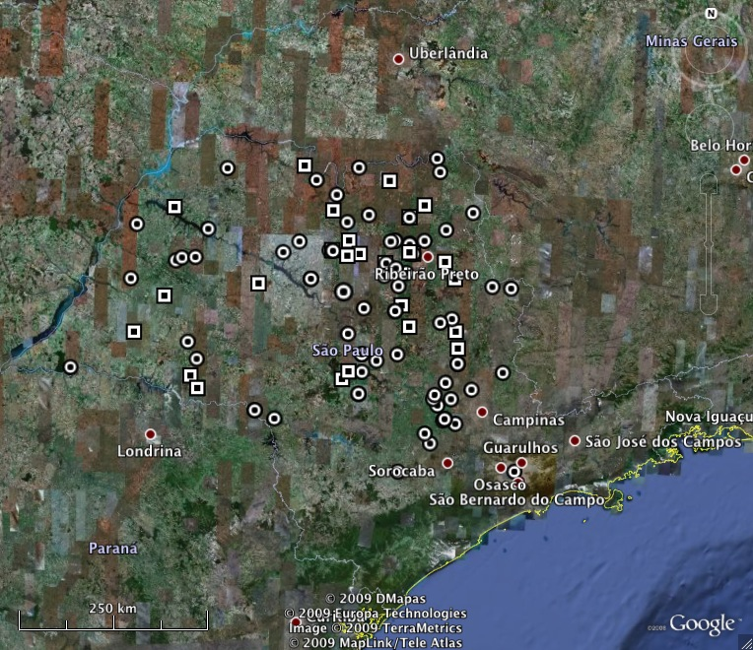
Sugar mills in Sao Paulo State, Brazil
Highlights
World’s largest sugarcane producer (33%)
Growing regions in NE & Central South
98% of production in CS, esp. Sao Paulo State
~400 mills
CDM
 Non-CDM

Slide 11
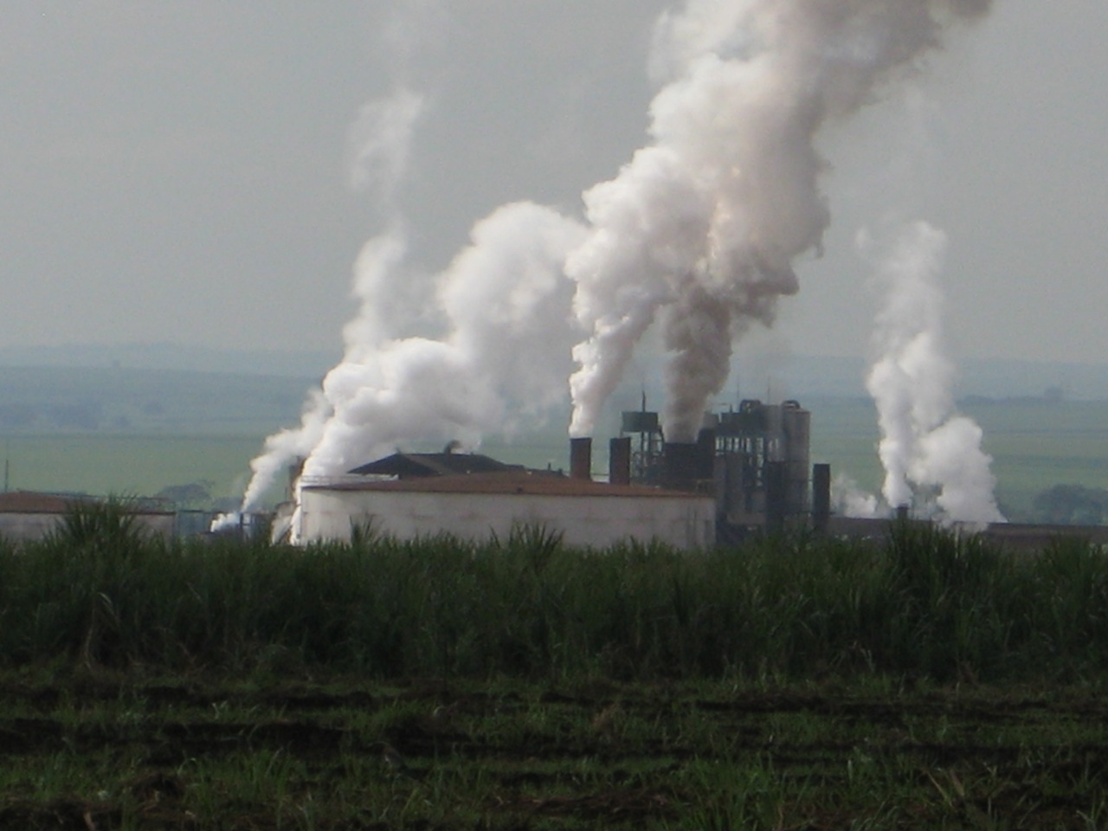
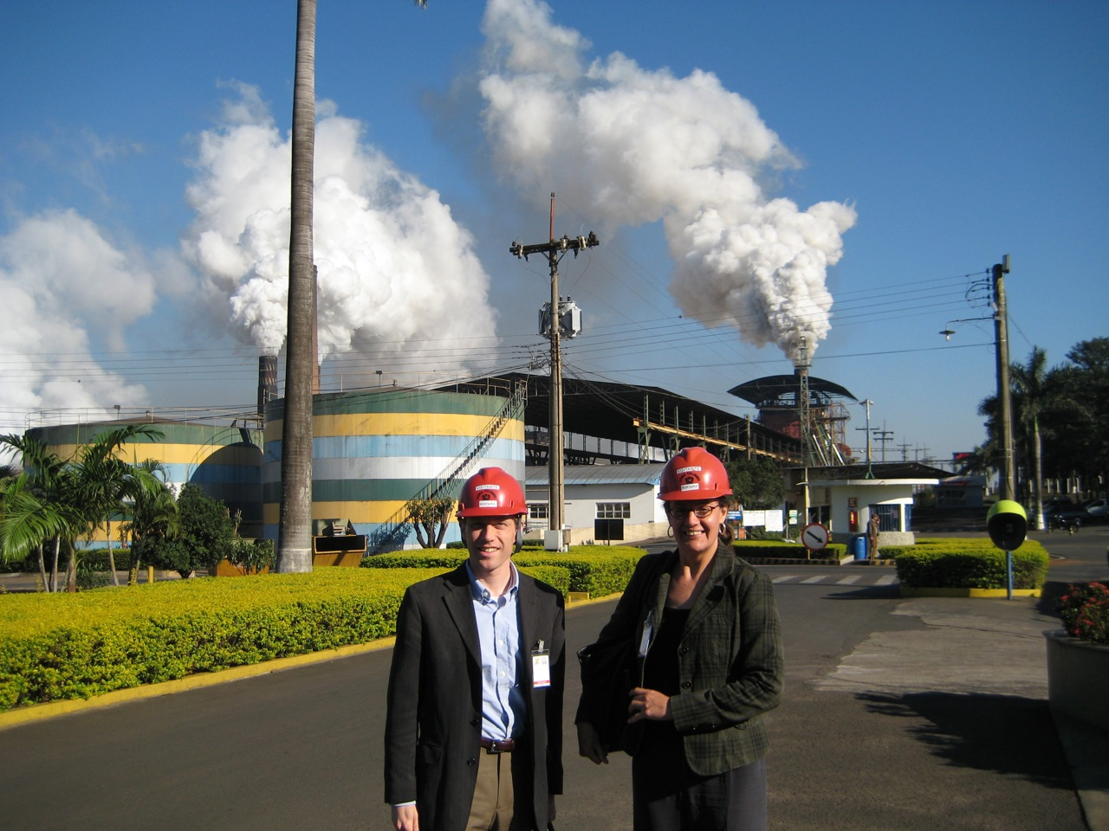

Slide 12
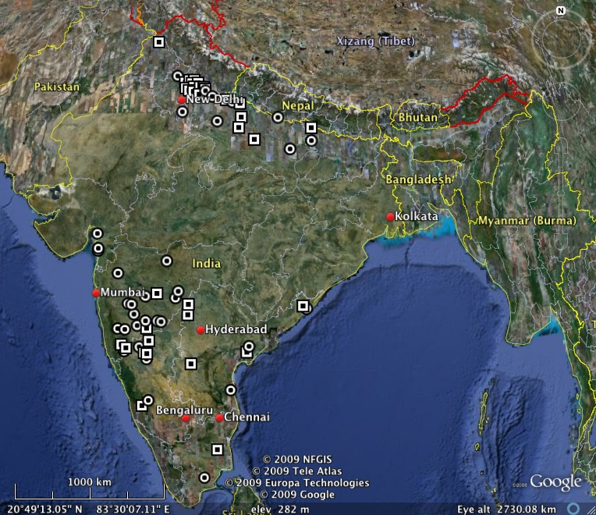
Sugar mills in India
Highlights
World’s 2nd largest sugarcane producer (23%)
Growing regions in North & Central West
580 mills
55% co-operative
CDM
 Non-CDM

Slide 13
Case technology: Bagasse Cogen
Energy efficiency projects
Bagasse fuel
Biomass = renewable
byproduct of sugarcane milling
Upgrade a low-efficiency boiler for a high-efficiency boiler to generate more electricity from the same amount of fuel
6.1% of expected CERs to 2012 in India
5.2% of expected CERs to 2012 in Brazil
Fraction of mills undertaking CDM project
77 out of 559 (15%) in India
60 out of 417 (14%) in Brazil

Slide 14
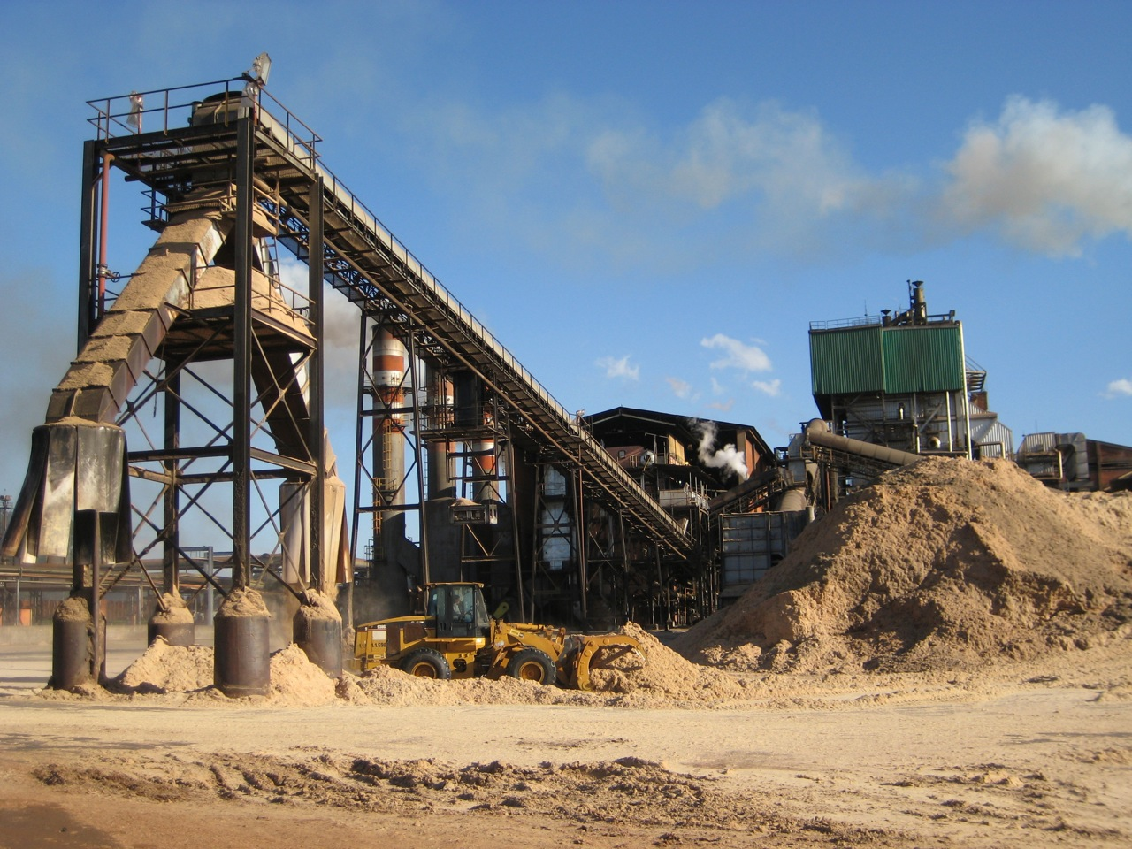
Bagasse cogeneration

Slide 15
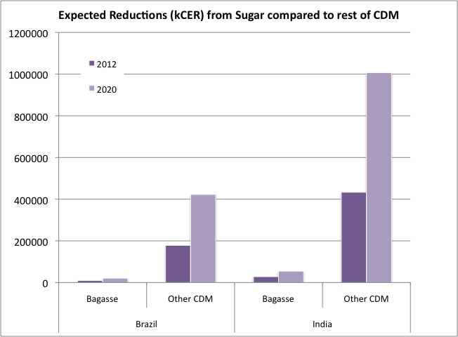
Reductions from sugar bagasse projects compared to rest of CDM in India & Brazil
Source: Risø Centre CDM Pipeline March 2009

Slide 16
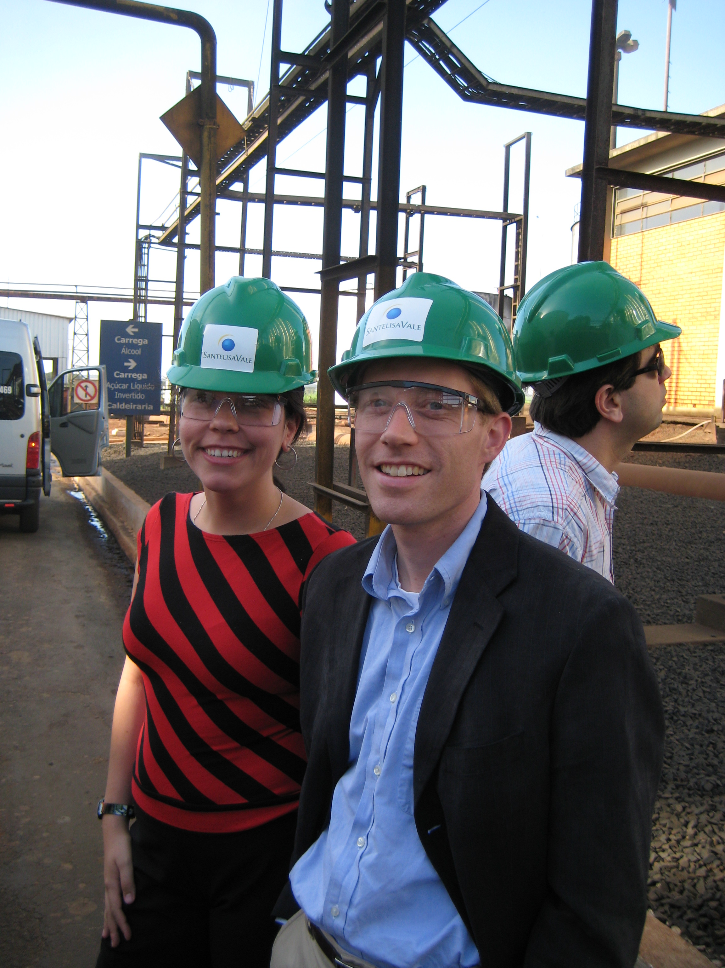
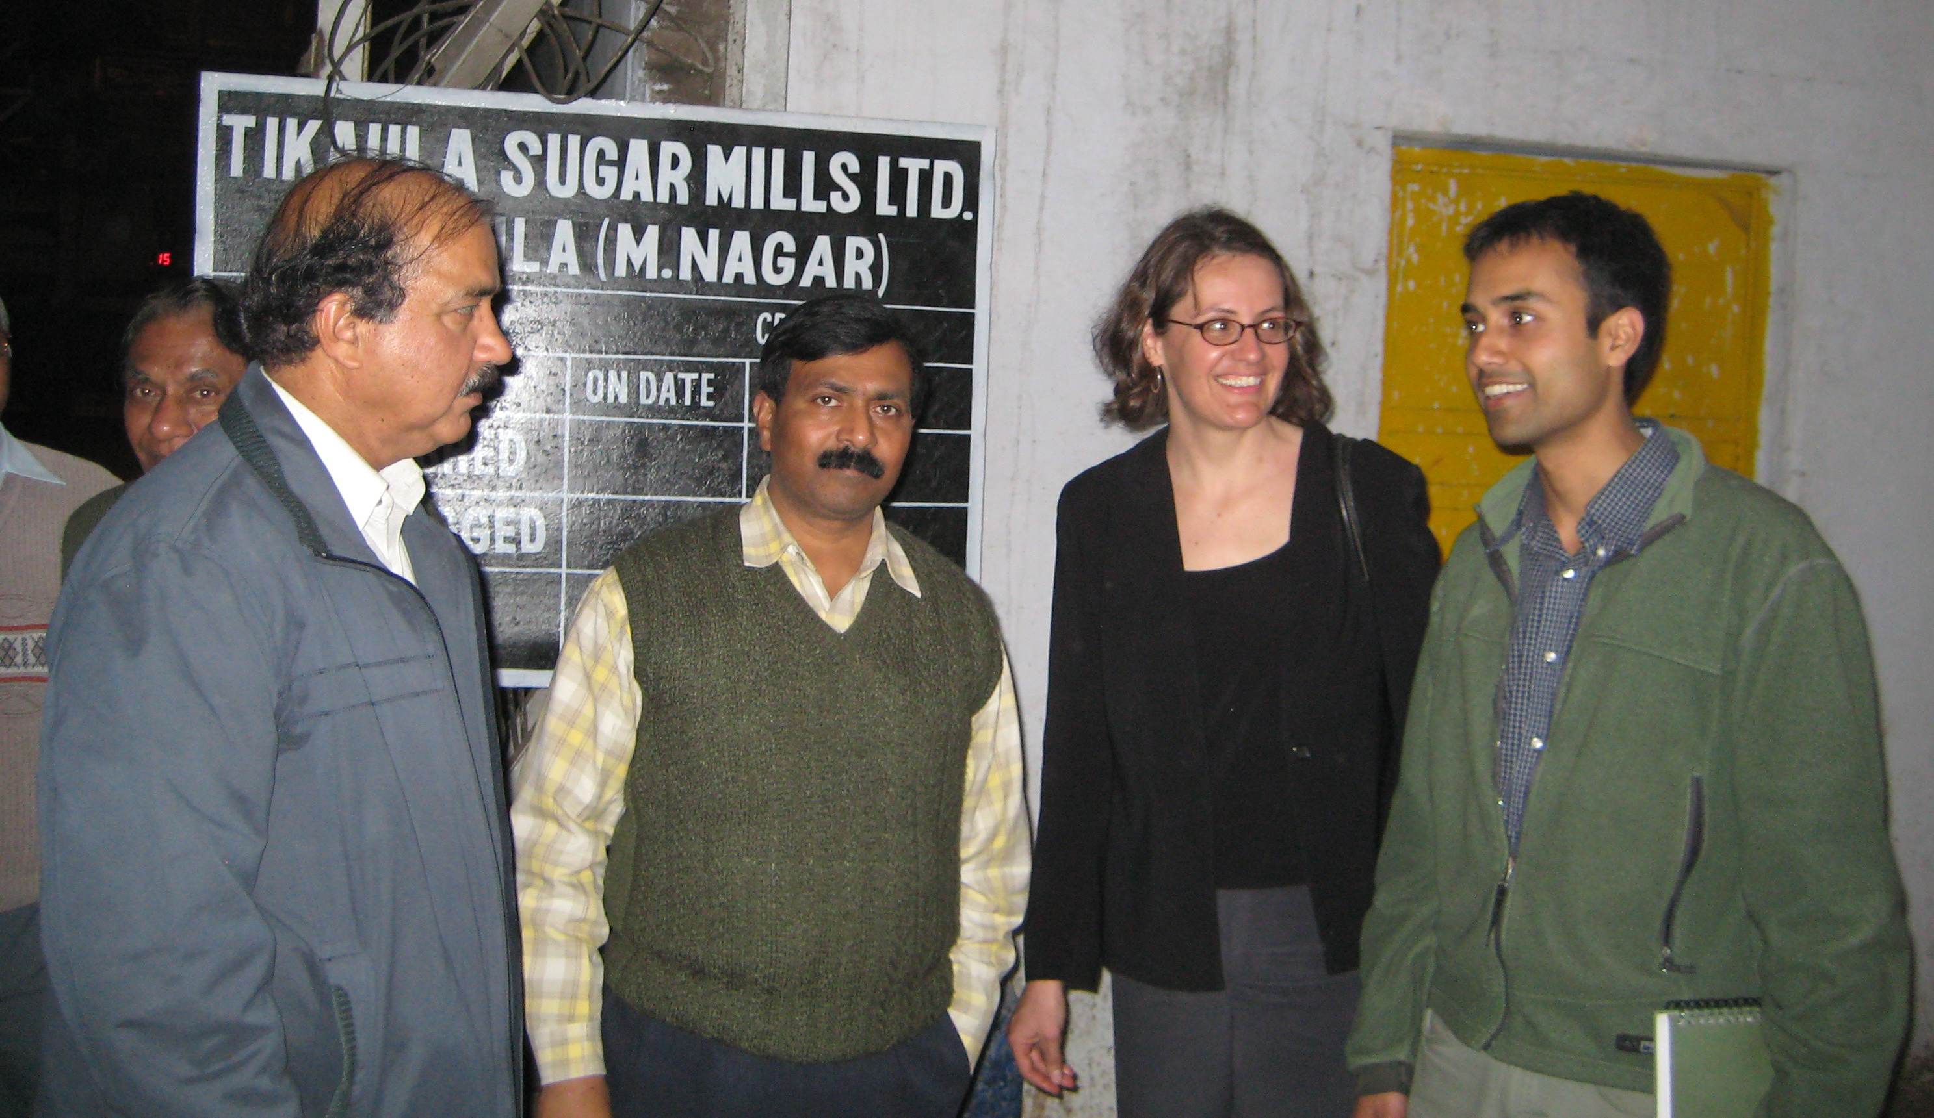
Data collection
Pilot phase
Brazil sugar sector (Jun 2008)
Context interviews (n=13)
Firm interviews (n=10)
India sugar and cement sectors (Jan 2009)
Context interviews (n=22)
Firm interviews (n=5)
Ongoing data collection
February-December 2009
Random sample
30 CDM firms and 30 non-CDM firms (N=60) for each of four country/sector pairs (N=240)
Archival and database research
Experts
industry trade association representatives
carbon market consultants
CDM project developers
CDM project verifiers (auditors)
academic experts
state and national government agency representatives
representatives from international orgs engaged in the carbon market
local/national environmental advocacy NGOs.
This paper is based on approximately 75 firm interviews and 40 expert interviews

Slide 17
Results 1. Domestic Policy Regime
India
Brazil
DNA filtering
Open on Sustainability
Open on Methodology
India’s goal was to adhere to the guidance and delegate assessment to outside entities
Effect was to encourage a wide variety of intermediaries
DNA filtering
Open on Sustainability
Stringent on Methodology
Brazil’s goal was to create a better CDM and possibly a comparative advantage by establishing a brand of quality
Effect was to favor a smaller number of skilled, specialist intermediaries

Slide 18
Results 2. Carbon market Intermediaries
India
Brazil
Many initial sugar projects were organized by the multinational consultancies of Ernst & Young and PriceWaterhouseCoopers
Continued to expand after initial projects
Niche consultancies Ecoinvest and Econoergy arose in Brazil specifically to undertake sugar sector CDM projects
Some of the early information advantage within these consultancies stemmed from their close family ties to the sugar industry
They did not expand substantially after initial success

Slide 19
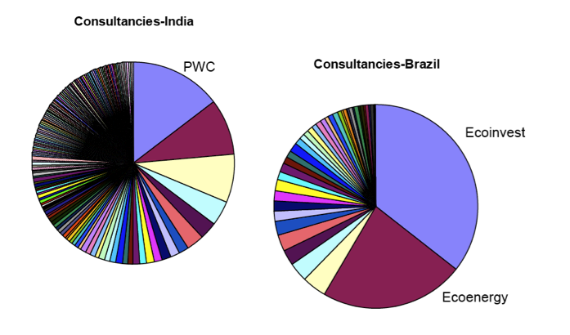
Current distribution of Consultants in Brazil & India
Source: Risø Centre CDM Pipeline March 2009

Slide 20
Consultant Intermediaries: Brazil sugar
Source: Risø Centre CDM Pipeline March 2009

Slide 21
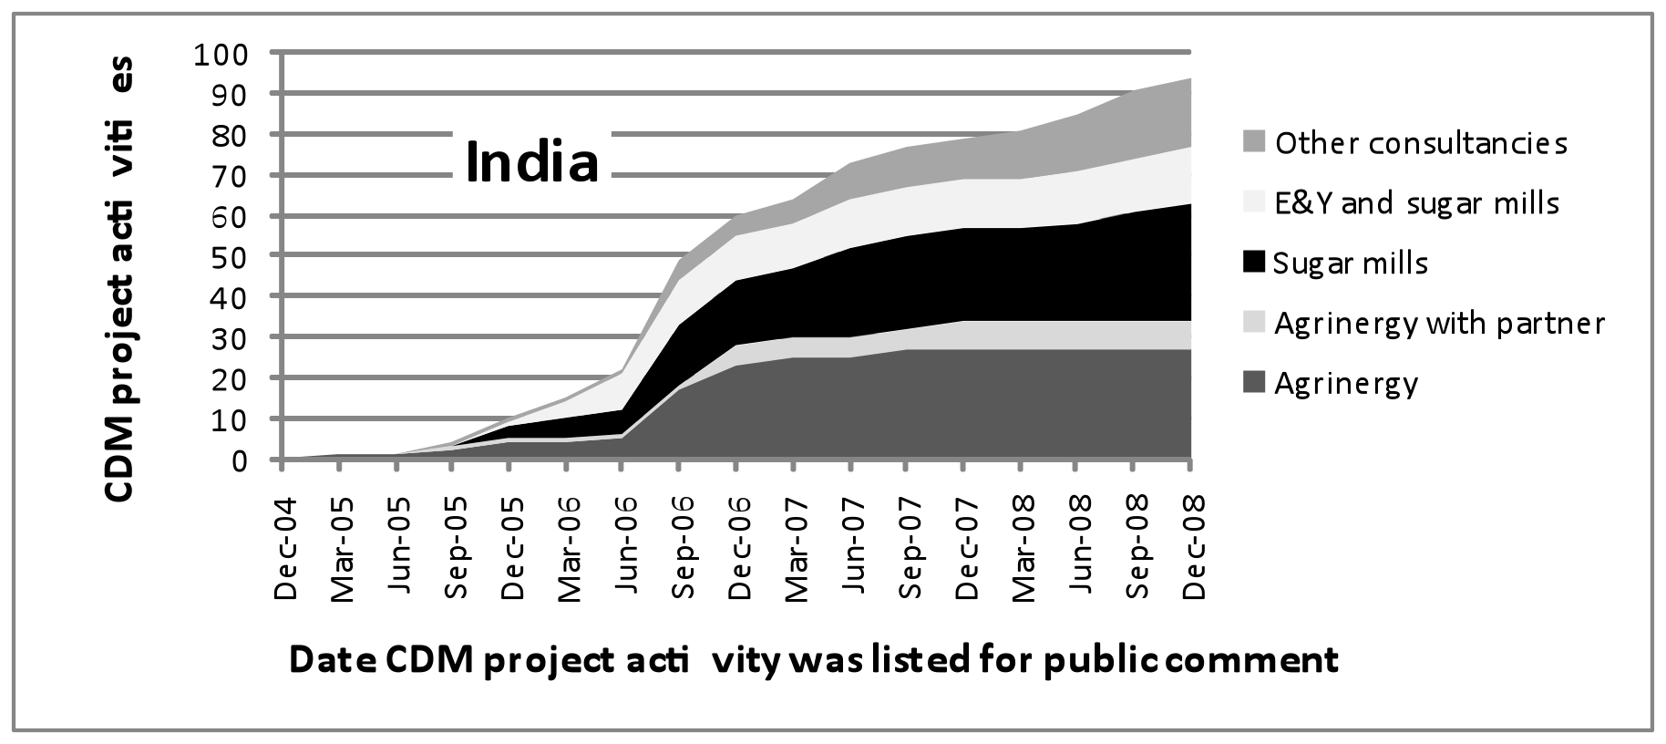
Consultant Intermediaries: India sugar
Source: Risø Centre CDM Pipeline March 2009

Slide 22
Results 3. International decisions
India
Brazil
Was not obviously harmed from changes in Methodology (AM0015 vs ACM0006)
Was not obviously disadvantaged by decisions on Grid Emissions Factor
International policy did not clearly harm the major multinational consultancies
Activity decreased markedly after changes in Methodology (AM0015 vs ACM0006)
Was clearly disadvantaged by decisions on Grid Emissions Factor until 2008 revision
Changes in international policy hurt the specialized intermediaries

Slide 23
Results 4. NGOs and Capacity Building
India
Brazil
Heavy capacity building activity of think tanks (notably TERI) and government entities
Little involvement by industry groups
Capacity building activity by government of questionable efficacy
No equivalent to TERI
Some involvement by industry groups

Slide 24
Pilot phase results: Relative importance of information sources (Brazil)
Source: Pulver, Hultman, Guimaraes submitted

Slide 25
Conclusions
In both countries, relationships to technical experts in the form of consultants were key to market expansion
Recommendation: focus on building expertise in the carbon market practitioners, rather than trying to reach individual firm managers.
Differences in domestic regulatory stringency did not lead to substantial differences in the overall adoption of carbon markets.
International policy risks were greater for specialized domestic intermediaries
Recommendation: Greater predictability could encourage domestically based practitioners

Slide 26
Acknowledgments
US National Science Foundation DRMS, IOS, GRS, & SOC
US-India Fulbright Senior Research Scholar program (SP)
University of São Paulo, Instituto de Electrotécnica e Energia
Prof Dr Sergio Pacca, USP
Prof Dr Adnei Melges de Andrade, USP
Prof Dr Aldo Roberto Ometto, USP São Carlos
Jawaharlal Nehru University
Prof Tiplut Nongbri, JNU
Prof Navroz Dubash, JNU
University of Maryland School of Public Policy (NH)
University of Maryland International Travel Fund (NH)
Brown University, Watson Inst. of International Studies (SP)
Brown University, Center for Environmental Studies (SP)

Slide 27
Extra slides

Slide 28
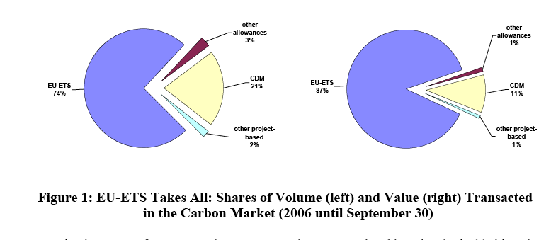
Carbon Market: Types of assets
Source: World Bank 2006

Slide 29
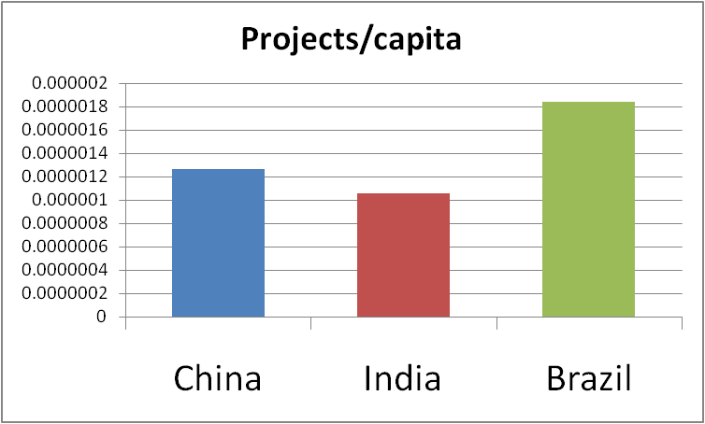
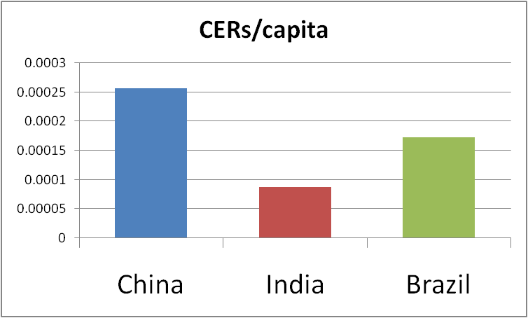
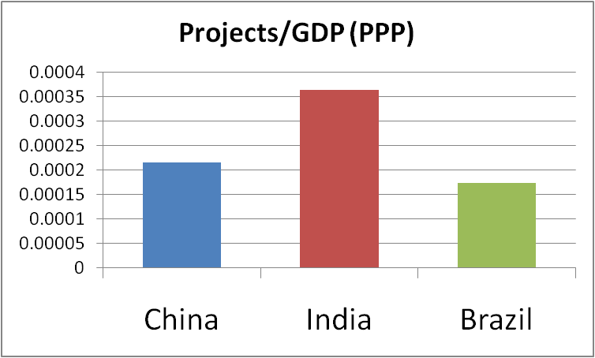
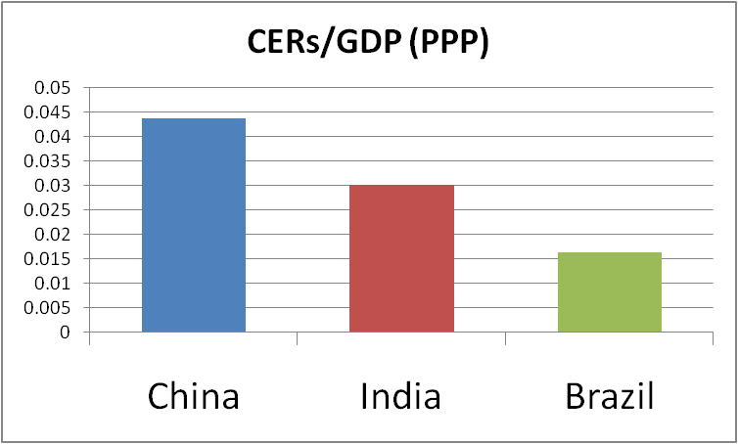
Notes:
3 top player
Different metrics

